Slide 1
Linux kernel networking acceleration using P4 on IPU

Slide 2
Agenda
Introduction
Architecture for IPU offloading – P4 Control Plane
P4 Control Plane (infrap4d) components
Linux Networking Pipeline
IPU HW Generic Block Diagram
Linux Networking tables to HW mapping
P4 Program snippets
Kernel Notifications to SAI and P4 Table mapping.
Packet processing in IPU and sending packets to Kernel
FRR Use Case
Useful Links

Slide 3
Introduction
Linux Kernel has a powerful networking stack that supports switching and routing capabilities, handles protocols such as LAG and ECMP, and can support connection tracking and security firewalls.
This presentation talks about how we use kernel tables and netlink notifications to accelerate routing capabilities, ECMP and CT from kernel to IPU
OpenvSwitch primarily uses this kernel stack to support most of the virtual switching capabilities.
With the Intel® IPU E2000 capabilities, we can accelerate most of the kernel networking stack in hardware.

Slide 4
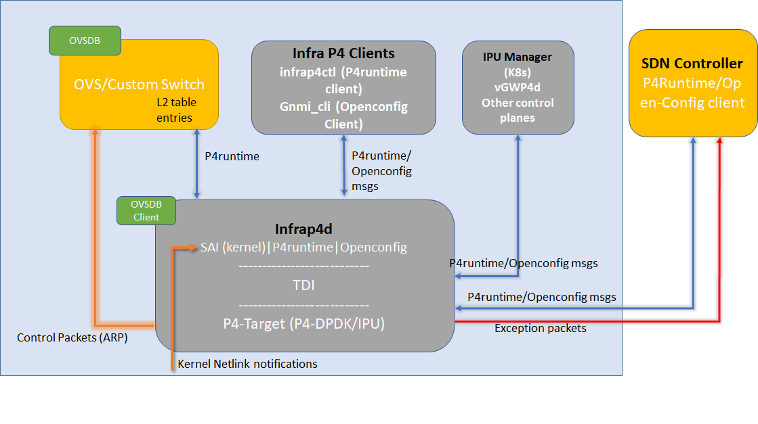
Architecture for IPU offloading – P4 Control Plane

Slide 5
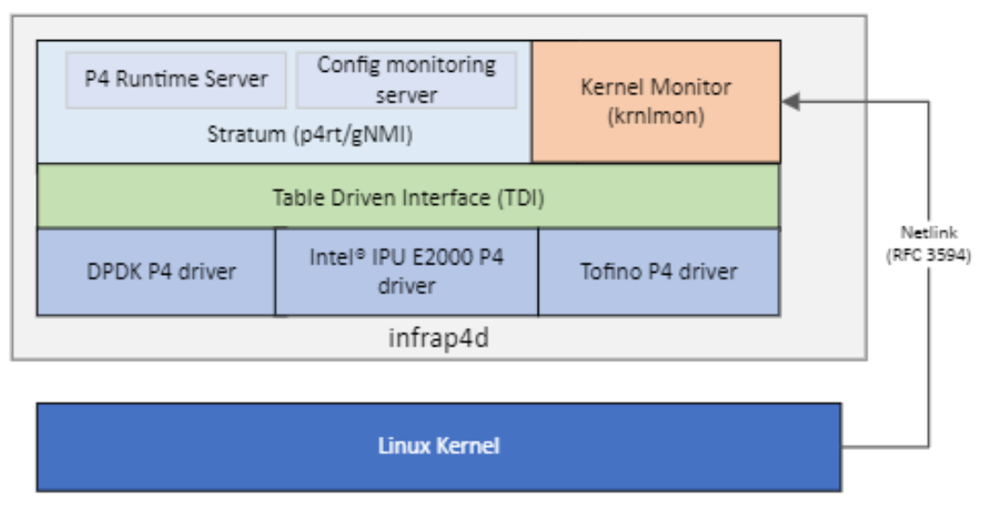
P4 Control Plane (Infrap4d)
Infrap4d
  Integrates Stratum, the Kernel Monitor (krnlmon), Switch Abstraction Interface (SAI), Table Driven Interface (TDI), and a P4 target driver into a separate daemon
Stratum
  provides the P4Runtime and OpenConfig capabilities for P4 flow rule offloads and configuration offloads.
TDI (Table Driven Interface)
  provides a target-agnostic interface to the driver for a P4-programmable device.
  It is a set of APIs that enable configuration and management of P4 programmable and fixed functions of a backend device in a uniform and dynamic way.
The Kernel Monitor
  receives RFC 3549 messages from the Linux Kernel over a Netlink socket in case of any modifications to kernel tables
  listens for network events (link, address, neighbor, route, tunnel, etc.) and programs the P4 tables via SAI and TDI.
Drivers
  Target specific driver code linked with TDI to interface with the HW/SW P4 dataplanes.
Fig. Infrap4d architecture

Slide 6
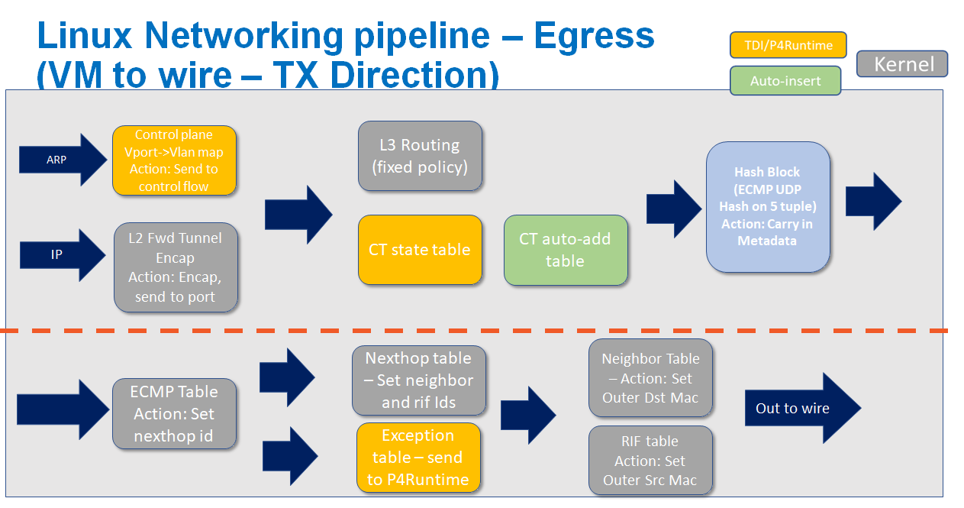

Slide 7
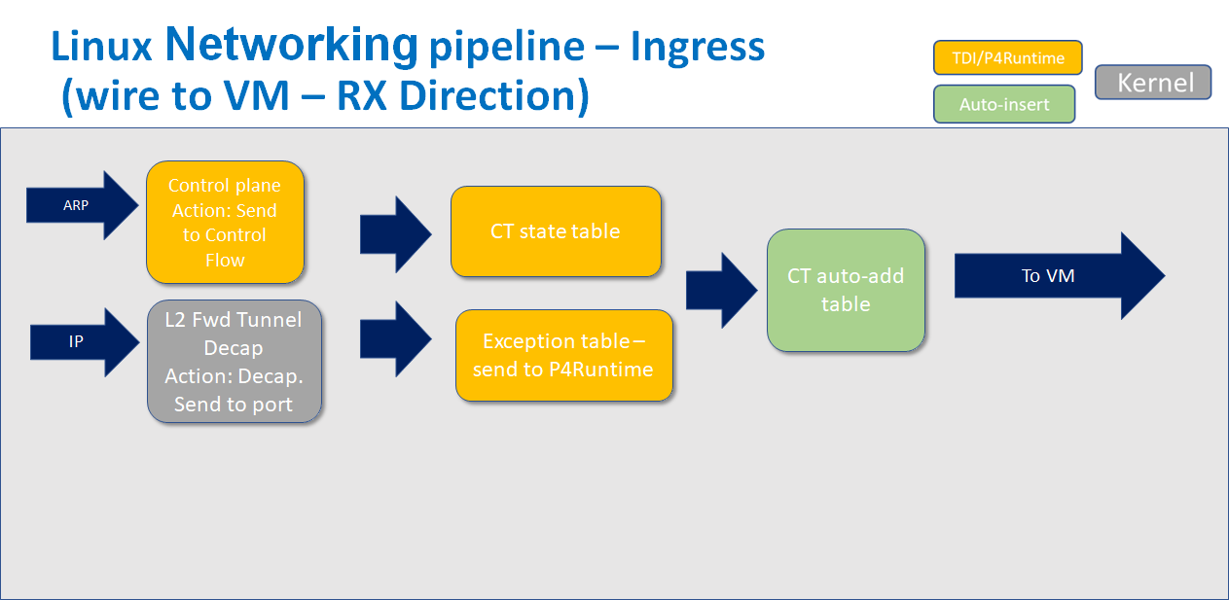

Slide 8
IPU HW blocks
Packet Re-circulation
Packet Arbitrator
Parser
Hashing
Packet Modifier
Exact Match
WCM
Recirculate packet
Re-circulate packet
LPM
Range Checker
Input rx/tx packet
Output rx/tx packet

Slide 9
P4 Table mappings on IPU HW blocks
P4 Table | IPU HW Block
VxLan match table | Exact Match
VxLan Encap/Decap tables | Modification
L2 table | Exact match
L3 Routing Table | Longest prefix match
ECMP table | Hash block
RSS | Hash block
Connection tracking state table | Wild Card Match
Connection tracking tuple table | Exact match with PNA add-on-miss capability
Exception table to SDN Controller | Exact match
Control vlan mapping table for ARP (going to OVS) | Exact Match

Slide 10
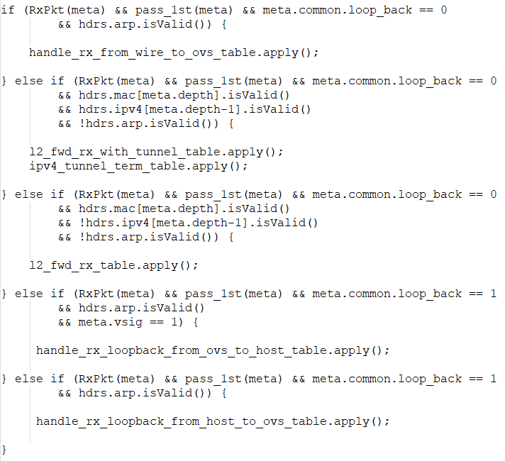
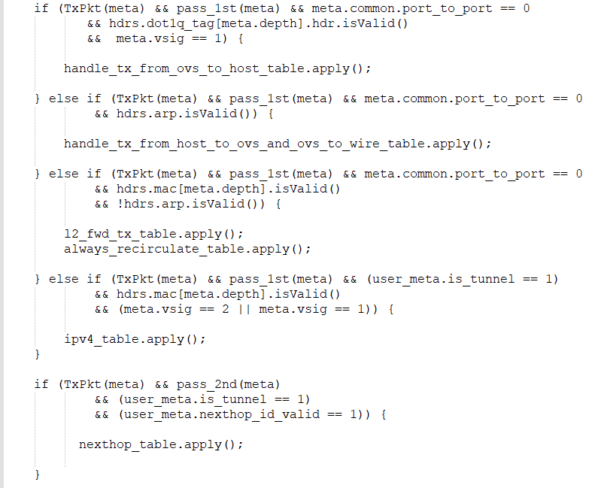
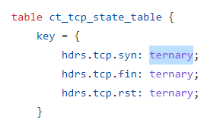
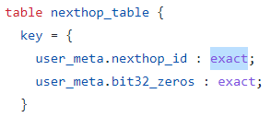
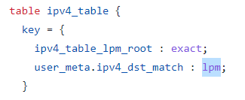
P4 Program Snippet and Match field usage

Slide 11
Kernel Notifications to SAI and P4 Table mapping.
Kernel Event | Netlink Type | SAI Call | P4 Table | Action
Underlay RIF/TEP create | RTM_NEWLINK RTM_DELLINK | create_router_interface | l2_fwd_rx_table | l2_fwd(port_id)
TEP/RIF IP address assign & assign route | RTM_NEWADDR RTM_DELADDR | create_next_hop | N/A | N/A
 | RTM_NEWROUTE RTM_DELROUTE | create_route_entry | ipv4_table | ipv4_set_nexthop_id(nexthop_id)
 |  |  | rif_mod_table_start | set_src_mac_start(mac)
 |  |  | rif_mod_table_mid | set_src_mac_mid(mac)
 |  |  | rif_mod_table_last | set_src_mac_last(mac)
VxLAN port creation | RTM_NEWLINK RTM_DELLINK | create_tunnel | vxlan_encap_mod_table | vxlan_encap(src_addr, dst_addr, dst_port, vni)
 |  | create_tunnel_term_table_entry | ipv4_tunnel_term_table | decap_outer_ipv4(tunnel_id)

Slide 12
Kernel Event | Netlink Type | SAI Call | P4 Table | Action
Underlay ARP resolution | RTM_NEWNEIGH RTM_DELNEIGH | create_neighbor_entry | neighbor_mod_table | set_outer_mac(dst_mac_addr)
 |  |  | nexthop_table | set_nexthop(RIF, neighbor_id, phy_port_id)
 |  | create_fdb_entry | l2_fwd_tx_table | l2_fwd(underlay_port_id)
OvS Event | SAI Call | P4 Table | Action
Overlay FDB learn (on VLAN netdev) | create_fdb_entry | l2_fwd_tx_table | l2_fwd(VF_port_id)
 |  | l2_fwd_rx_with_tunnel_table | l2_fwd(VF_port_id)
Overlay FDB learn (on VxLAN netdev) | create_fdb_entry | l2_fwd_tx_table | set_tunnel(tunnel_id, dst_addr)

Slide 13
Topology
HOST SERVER
IPU/ACC
BR-INT
P4rt-ctl
P4Runtime
Client
GNMI-CLI
OpenConfig
Client
FDB
EVENTS
VM1
VM2
VM128
VM129
VM256
OvS VxLAN logical port
Infrap4d
…
…
…
…
VXLAN0
gRPC Server
VLAN1
NETDEV
VLAN2
NETDEV
VLAN128
NETDEV
VLAN129
NETDEV
VLAN256
NETDEV
P4Runtime
Service
OpenConfig
Service
VPORT/VF PORT PR Devices
VF Drivers
IDPF
IAVF
VLAN
Driver
TDI Calls
VXLAN-SYS
NETDEV
Stratum
HOST1 NETDEV
Linux Tunnel NETDEV created by OvS tunnel config
VxLAN
Driver
krnlmon
P4SDE
idpf
idpf
i`dpf
idpf
idpf
BONDING DUMMY
NETDEV
TDI
APF NETDEVs
HOST NETDEV
COMMS APF NETDEV
SWITCH API
SAI
PipeMgr
PortMgr
HOST
NETDEV
Comms
NETDEV
BONDING
Driver
SWITCH LINK
CPFLib
…
VFIO-PCI
Driver
P0 NETDEV
P1 NETDEV
FRR (BGPd)
NETLINK
FRAMEWORK
IDPF
Driver
IDPF
Driver
VFIO-PCI
Driver
VF0
VF1
VF127
VF128
VF255
APF
APF
CPF
P0
vPORT
VSI
P1
vPORT
VSI
HOST
vPORT
VSI
vPORT
VSI
vPORT
VSI
vPORT
VSI
vPORT
VSI
vPORT
VSI
vPORT
VSI
vPORT
VSI
vPORT
VSI
vPORT
VSI
Exception Traffic
FXP PIPELINE
P0
PHY PORT
P1
PHY PORT

Slide 14
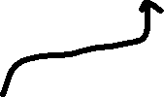

ARP resolution and IPU Programming
HOST SERVER
IPU/ACC
BR-INT
P4rt-ctl
P4Runtime
Client
GNMI-CLI
OpenConfig
Client
FDB
EVENTS
VM1
VM2
VM128
VM129
VM256
OvS VxLAN logical port
Infrap4d
…
…
…
…
VXLAN0
gRPC Server
VLAN1
NETDEV
VLAN2
NETDEV
VLAN128
NETDEV
VLAN129
NETDEV
VLAN256
NETDEV
P4Runtime
Service
OpenConfig
Service
VPORT/VF PORT PR Devices
VF Drivers
IDPF
IAVF
VLAN
Driver
TDI Calls
HOST1 NETDEV
VXLAN-SYS
NETDEV
Stratum
Linux Tunnel NETDEV created by OvS tunnel config
P4SDE
idpf
idpf
i`dpf
idpf
idpf
BONDING DUMMY
NETDEV
VxLAN
Driver
krnlmon
TDI
APF NETDEVs
HOST NETDEV
COMMS APF NETDEV
SWITCH API
SAI
PipeMgr
PortMgr
HOST
NETDEV
Comms
NETDEV
BONDING
Driver
SWITCH LINK
CPFLib
…
VFIO-PCI
Driver
P0 NETDEV
P1 NETDEV
FRR (BGPd)
NETLINK
FRAMEWORK
IDPF
Driver
IDPF
Driver
Dynamic Neighbors learnt by Kernel are sent to userspace via netlink.
VFIO-PCI
Driver
VF0
VF1
VF127
VF128
VF255
APF
APF
CPF
vPORT
VSI
vPORT
VSI
vPORT
VSI
vPORT
VSI
vPORT
VSI
vPORT
VSI
vPORT
VSI
P0
vPORT
VSI
P1
vPORT
VSI
HOST
vPORT
VSI
vPORT
VSI
vPORT
VSI
FXP PIPELINE
Table | Match Key | Action
l2_fwd_rx_table | P0 Netdev | l2_fwd(P0)
neighbor_mod_table | nbr_id | set_outer_mac(dmac)
P0
PHY PORT
P1
PHY PORT

Slide 15
FRR Use Case
FRR provides IP routing services. FRR installs routing decisions into the OS kernel, allowing the kernel networking stack to make the corresponding forwarding decisions.
Dynamic routes learnt by FRR are programmed in kernel and these result in a netlink notification for the SAI switchLink in p4 control plane.
Based on the route learns, p4 control plane programs the specific tables in the target with proper match-fields and action to perform when the key matches.

Slide 16
FRR Route Learn and IPU Programming
HOST SERVER
IPU/ACC
BR-INT
P4rt-ctl
P4Runtime
Client
GNMI-CLI
OpenConfig
Client
FDB
EVENTS
VM1
VM2
VM128
VM129
VM256
OvS VxLAN logical port
Infrap4d
…
…
…
…
VXLAN0
gRPC Server
VLAN1
NETDEV
VLAN2
NETDEV
VLAN128
NETDEV
VLAN129
NETDEV
VLAN256
NETDEV
P4Runtime
Service
OpenConfig
Service
VPORT/VF PORT PR Devices
VF Drivers
IDPF
IAVF
VLAN
Driver
TDI Calls
VXLAN-SYS
NETDEV
Stratum
HOST1 NETDEV
Linux Tunnel NETDEV created by OvS tunnel config
VxLAN
Driver
krnlmon
P4SDE
idpf
idpf
i`dpf
idpf
idpf
BONDING DUMMY
NETDEV
TDI
APF NETDEVs
HOST NETDEV
COMMS APF NETDEV
SWITCH API
SAI
PipeMgr
PortMgr
HOST
NETDEV
Comms
NETDEV
BONDING
Driver
SWITCH LINK
CPFLib
…
VFIO-PCI
Driver
P0 NETDEV
P1 NETDEV
FRR (BGPd)
NETLINK
FRAMEWORK
IDPF
Driver
IDPF
Driver
Dynamic routes learnt by FRR-BGPd will be programmed in kernel
VFIO-PCI
Driver
VF0
VF1
VF127
VF128
VF255
APF
APF
CPF
vPORT
VSI
vPORT
VSI
vPORT
VSI
vPORT
VSI
vPORT
VSI
vPORT
VSI
vPORT
VSI
P0
vPORT
VSI
P1
vPORT
VSI
HOST
vPORT
VSI
vPORT
VSI
vPORT
VSI
FXP PIPELINE
Table | Match Key | Action
ipv4_table | ipv4_dst_match | set_nexthop_id(id)
nexthop_table | nexthop_id | set_nexthop(id, nbr_id, port)
P0
PHY PORT
P1
PHY PORT

Slide 17
Recap
Control plane rules are programmed in IPU to forward packet between
  Physical port to Kernel netdev and vice-versa.
  Vport to Kernel netdev with adding VLAN tag and vice-versa (by removing VLAN tag).
Overlay control packets are handled by OvS and IPU is programmed with rules.
Underlay control packets are handled by Kernel and P4 control plane programs the IPU with rules based on RTM_GETNEIGH netlink message.
Route to reach remote VTEP are learnt by FRR-BGPd and updated in kernel. These routes are programmed in IPU by P4 control plane based on RTM_GETROUTE netlink message.

Slide 18
Useful links
“P4: programming protocol-independent packet processors” by Nick McKeown and others - https://dl.acm.org/doi/10.1145/2656877.2656890
“P4-OVS” - https://github.com/ipdk-io/ovs
“P4-DPDK” - https://github.com/DPDK/dpdk
“TDI” - https://github.com/DPDK/dpdk
“P4-DPDK-Backend” - https://github.com/p4lang/p4-dpdk-target
“PNA” - https://p4.org/p4-spec/docs/PNA.html
“IPDK” - https://ipdk.io/
“Linux Networking P4 file” - https://github.com/ipdk-io/ovs/tree/ovs-with-p4/p4proto/p4src/linux_networking

